Slide 1
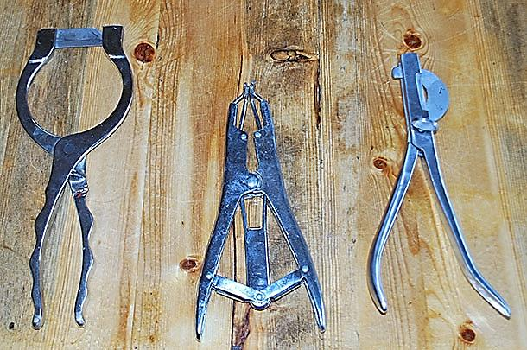
Large animal castration
Instruments used in large animal castration

Slide 2
Large animal castration

Slide 3
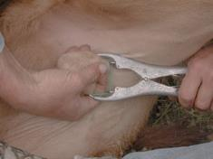
Large animal castration
Elastrator

Slide 4
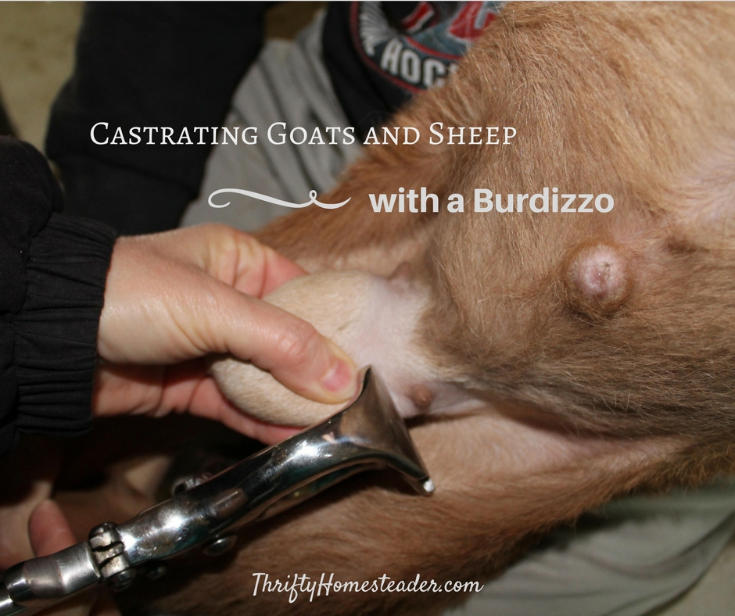
Large animal castration

Slide 6
complication
● Hemorrhage,
● scrotal hematoma,
● scrotal bruising,
● infection,
● dehiscence,
● urinary incontinence,
● Behavior change

